Slide 1
An Anti-Bullying Assembly
By Year 6

Slide 2
What you have heard are examples of bullying.
Bullying can occur anywhere and to anyone. It can happen online (cyberbullying) or face-to-face. Bullying doesn’t have to be physical, but children that bully others tend to use whatever source of strength they have to hurt. Using a source of strength, possibly with the help of others, to repeatedly make one person feel bad about themselves is a common aspect of bullying behaviour.

Slide 3
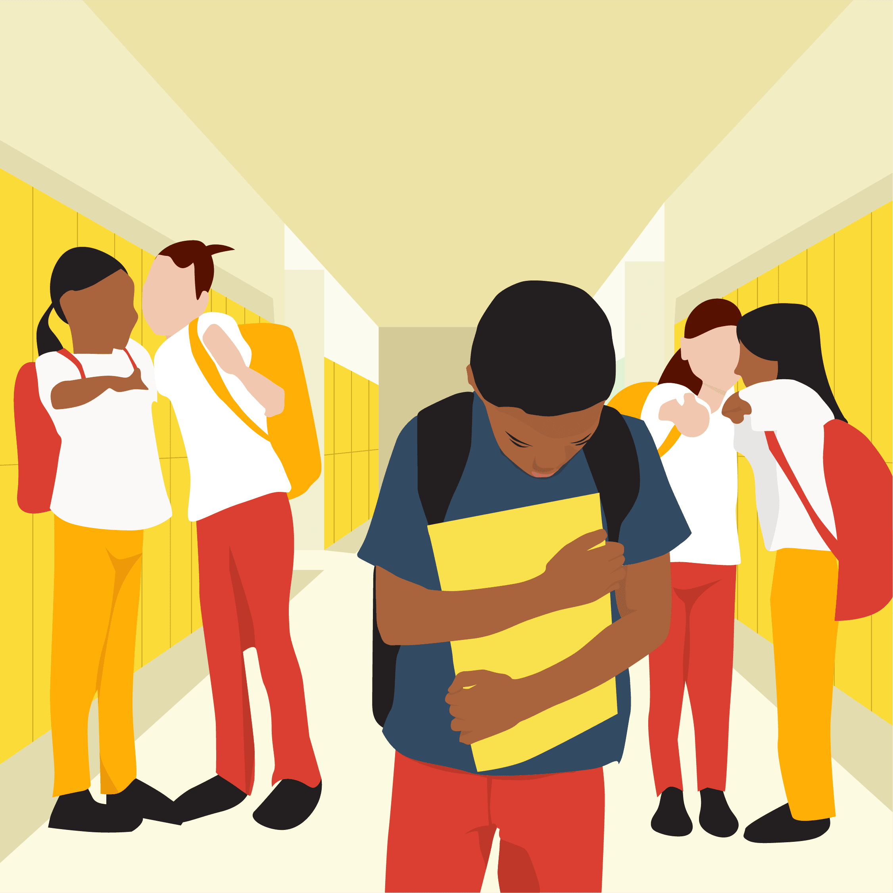
Examples of Bullying include:
Intentionally hurting someone outside on the playground.
Whispering nasty names to another in class
Destroying/stealing other children’s belongings
Making fun of someone/laughing at someone
Remember bullying is over a period of time/continuously

Slide 4
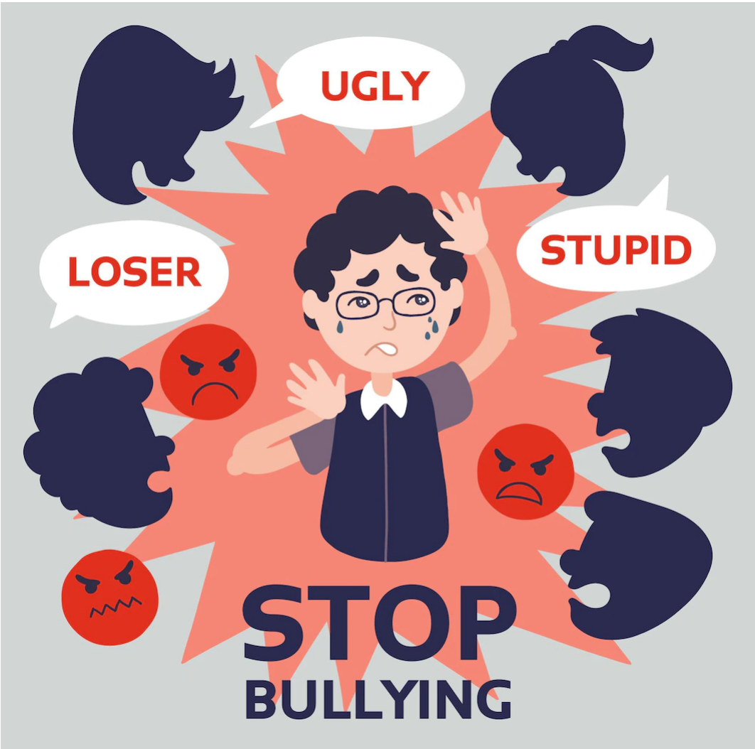
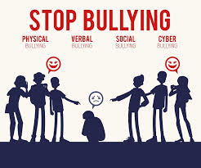
Bullying is repeated activity. This doesn’t include:
Having an argument one break time with your friends or best friends
Disagreeing with someone’s point of view
Unintentionally hurting someone

Slide 5
Bullying makes people feel….
Unhappy

Slide 6
We are a Rights Respecting School
Every child has the right to an education – to learn in a place where they feel safe and feel they belong
They have the right to be protected from violence and discrimination.
Everybody must play their part in ensuring that this is the case for every child

Slide 7
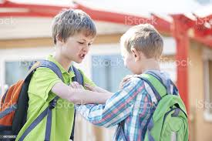
These are two scenarios:
Scenario A
Scenario B
Stacey and Toni were going to the one day and they saw a younger girl on her scooter. They pushed her off and walked away. They continued to do this every week.
Darren and George had a fight about what game they wanted to play. Darren wanted to play tennis but George wanted to play football.
Which one is bullying?
How could the little girl stop Stacey and Tracey from bullying her?

Slide 8
How can we stop it?
We can all stop bullying by:
- Telling a trusted adult. This could be your teacher,
or other adults in the school or on the playground.
You could ask a friend to help if you feel worried
about talking about it.
Don’t retaliate.
Stand together and say NO! Don’t watch and let it happen
Use an online incident form to report incidents
online or on social media.
Everybody has a part to play…

Slide 9
How can we stop it?
Remember to respect other people!
Just because someone is different to you and your friends – that doesn’t mean you are better than them or have a right to make them feel bad. If you mess up, say sorry. You don’t have to be friends with everyone – but you should always make it clear that you don’t like it when people bully others, and stick up for people who are having a hard time.

Slide 10
Thank you for listening. Remember we can all make a difference
By Phoebe, Jorgie, Cayden,
Jamie, Emily, Nustrat, Rita, Ethan and Ava

