Slide 1
Springfield Junior School
Parent Information
RSE

Slide 2
We aim to inform you about:
• the school’s legal obligations on Relationships and Sex Education
• your rights as a parent/carer
• how, what, why and when we intend to teach children.

Slide 3
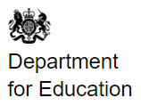
The Health Education and Relationships Education aspects of PSHE (personal, social, health and economic) education has been compulsory in all primary schools from September 2020.
• The Department for Education published statutory guidance for Health Education, Relationships Education and RSE in June 2019.
• This covers broad areas of particular relevance and concern to children and young people today.
It should ensure that every child is guaranteed a PSHE education that covers mental health and wellbeing, physical health (including healthy lifestyles and first aid) and learning about safe, healthy relationships, including understanding consent and negotiating life online.

Slide 5
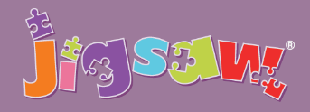
A whole-school PSHE programme comprising:
• A comprehensive and completely original scheme of work for ages 3 to 16
• PSHE (Personal, Social, and Health Education) Includes statutory Relationships and Health Education
• A detailed weekly lesson plan for all year groups, including all teaching resources
• The Jigsaw Approach, underpinned by mindfulness
• Assemblies, Jigsaw Friends, Jigsaw Chimes, original music and songs

Slide 6
Why is SRE taught in schools?
There are many reasons why SRE is taught in schools:
• It is part of the National Science Curriculum.
• More than ever before, children are exposed to representations of sex and sexuality through the media and the social culture around them, so we need to present a balanced view of SRE.
• Research shows that most parents say they want the support of schools in providing SRE for their children.
• Research consistently shows that effective SRE delays first sexual experience and reduces risk-taking.
• Surveys of children and young people have repeatedly stated that SRE tends to be “too little, too late and too biological”.
Jigsaw, believes that knowledge empowers children to make informed decisions that help keep them safe, healthy and happy

Slide 7
What will my child actually be taught?
The ‘Changing Me’ unit is taught over a period of 6 weeks in the second half of the summer term. Each year group will be taught appropriate to their age and development stage.
Please note: at no point will a child be taught something that is inappropriate; and if a question from a child arises and the teacher feels it would be inappropriate to answer, (for example, because of its mature or explicit nature), the child will be encouraged to ask his/her parents or carers at home, and the question will not be answered to the child or class if it is outside the remit of that year group’s programme.
Year 3 How babies grow and how boys’ and girls’ bodies change as they grow older
Year 4 Internal and external reproductive body parts, body changes in girls and menstruation
Year 5 Puberty for boys and girls, and conception
Year 6 Puberty for boys and girls and understanding conception to birth of a baby
All lessons are taught using simple, child-friendly language and pictures, which help children understand changes more effectively.
The key concepts that children learn in Jigsaw are inner strength, self-esteem and resilience. These are really important as they help keep children safe and it helps children to make healthy decisions later in life. Accurate information is important but only part of the picture: help them now by building their inner resilience, so they become mindful children, mindful teenagers, and mindful adults.

Slide 8
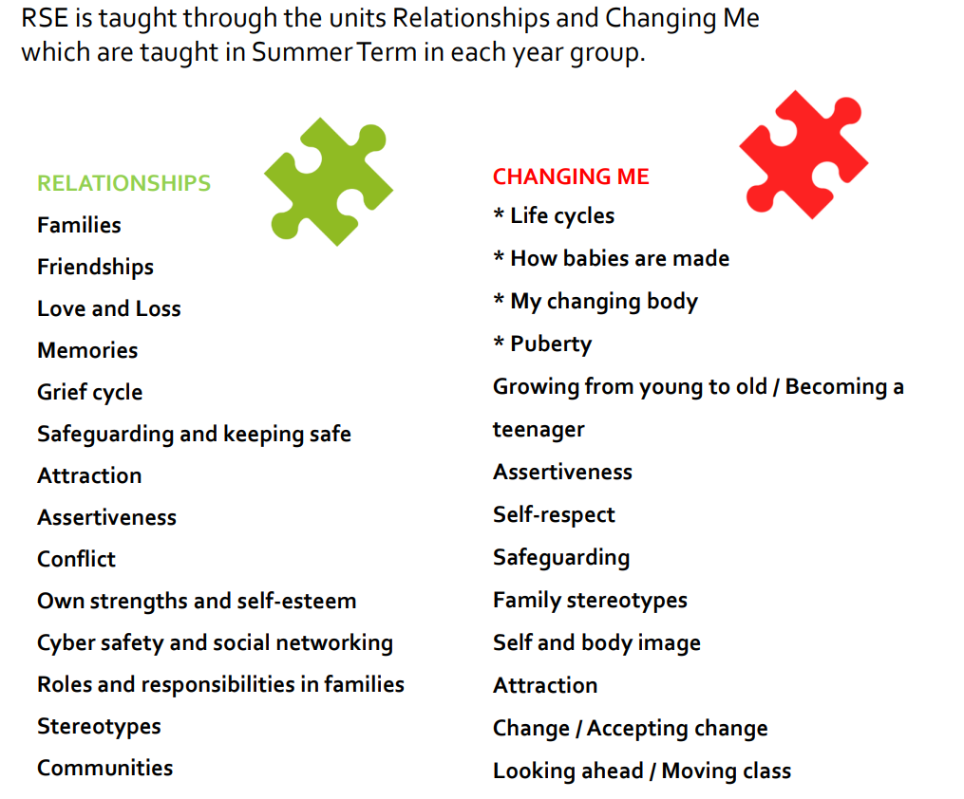

Slide 9
Year 3

Slide 11
Year 4

Slide 13
Year 5

Slide 15
Year 6

Slide 17
Won’t telling my child about human reproduction take away his/her innocence?
No. The evidence suggests that high quality SRE does the opposite: it actually delays young people’s first sexual experience, and it helps them become much more confident and comfortable about making informed choices.
Good SRE takes away children’s ignorance, not their innocence.
Teaching about safety and relationships as part of PSHE Education contributes to how schools approach the safeguarding of pupils. It helps them to recognise when they and others are at risk and equips them with the skills, strategies and language they need to take appropriate action.
This is crucial to fulfilling statutory duties in relation to safeguarding pupils as well as to meeting Ofsted expectations.
Ofsted expressed concern in its 2013 PSHE report that a lack of high-quality, age-appropriate SRE in over a third of schools left young people vulnerable to inappropriate sexual behaviours and exploitation.
It is clear, therefore, that PSHE Education plays a vital part in helping to meet school’s responsibilities to safeguard their pupils, your children.

Slide 18
Is it true I can withdraw my child?
Yes, it is. Parents/carers have the legal right to withdraw their children from the SRE included in the PSHE Education curriculum (as that is a non-statutory subject). But they are not permitted to withdraw their child from the Sex Education included in the National Curriculum Science Orders, as Science is a statutory subject.
The (non-statutory) lessons your child can be withdrawn from are:
Year 4, Lesson 2 (Having a baby)
Year 5, Lesson 4 (Conception)
Year 6, Lesson 3 (Conception to Birth)

Slide 19
If you are considering taking your child out of SRE lessons within PSHE Education, please consider the following:
• All the other children in your child’s class will have been taught this information and may well talk to your child about it, perhaps in the playground… and potentially mislead them or confuse them as a result. It may prove far better to allow experienced and sensitive teaching staff to teach your child in a progressive, developmental way that is grounded in research.
• They will be learning about reproduction in Science lessons. The SRE in PSHE Education will echo this and will concentrate on building self-esteem and teaching children how to enjoy healthy, appropriate relationships, improve self-esteem and self-confidence, and make healthy, informed choices. When viewed this way, it is hoped that SRE won’t be seen as contentious or a cause for concern, but rather as helpful.
• Access the lesson content so you are aware what is being taught and can discuss it with your child.

